Slide 1
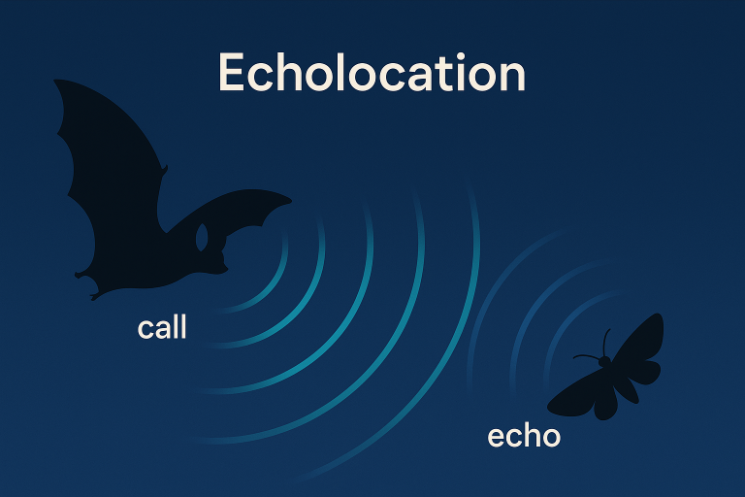

Slide 2
Echolocation is a system where animals make sounds and listen to the echoes to find objects.
Many animals use echolocation, such as bats, dolphins, whales, and some small mammals.
Humans can also use echolocation to understand their surroundings.
Humans create sounds by clicking their mouth, tapping a cane, snapping fingers, or stomping feet.
The sound waves bounce off nearby objects and return as echoes.
Trained people can use these echoes to know how far away an object is and how big it is.

Slide 3
Many blind people naturally notice echoes in their environment.
Some blind people actively make clicking sounds to help them move safely.
Both passive and active echolocation help blind people understand their surroundings.
Sighted people usually do not notice echoes because the brain suppresses them.
With practice, sighted people can also learn to use echolocation.
This shows that echolocation is a natural ability in humans.

Slide 4
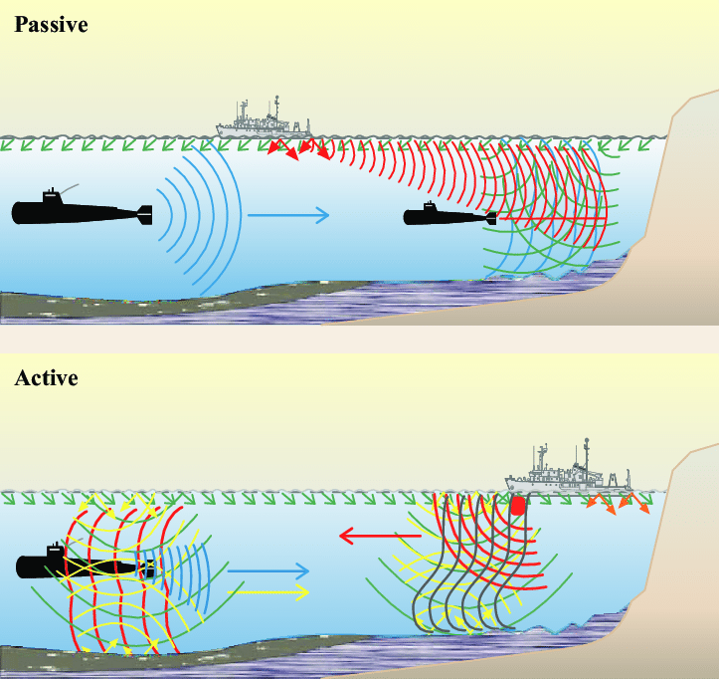

Slide 5
Technological Echolocation
Replicates the concept of biological echolocation using technological devices.
Utilizes sound waves, typically generated by artificial sources such as sonar or ultrasonic sensors.
These devices emit sound waves and analyze the echoes that bounce back from objects.
The information from the echoes is processed and interpreted by the technology to generate useful data, such as distance, location, and object recognition.
Technological echolocation has applications in various fields, including navigation, robotics, obstacle detection, and medical imaging.
It is a human-engineered solution inspired by the natural abilities of animals.

Slide 6
Echolocation works by:
Sending out sound waves
Letting the waves hit objects
Receiving the sound that bounces back
Mechanics
Vision and hearing are similar because both depend on reflected waves.
Vision → Eyes detect light waves that bounce off objects
Echolocation → Ears detect sound waves that bounce off objects
The brain studies these reflected waves to understand the surroundings.
When sound waves bounce back, they are called echoes.

Slide 7
An ultrasonic sensor is a device that uses high-frequency sound waves (ultrasound) to detect objects and measure distances.
It works on the same basic principle as echolocation used by bats.
How an Ultrasonic Sensor Works
The sensor emits ultrasonic sound waves
The waves travel through the air and hit an object.
The sound bounces back as an echo.
The sensor measures the time taken for the echo to return.
Distance is calculated from this time.

Slide 8
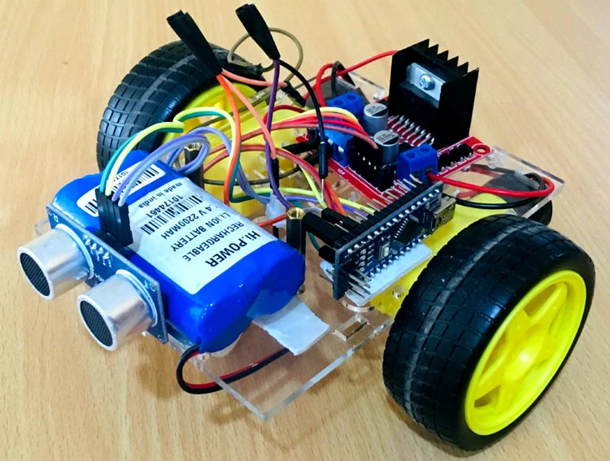
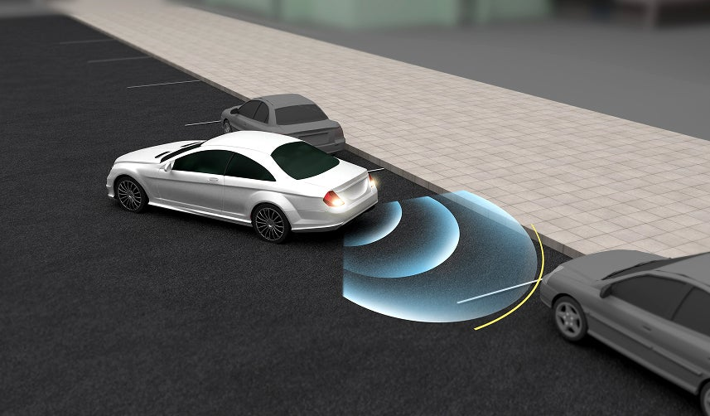
Ultrasonic Sensors in Robotics and Autonomous Vehicles

Slide 9
Use in Robotics: In robots, ultrasonic sensors help with:
Obstacle detection – Identify objects in the path Distance measurement – Know how far objects are Navigation – Move safely without collisions Object avoidance – Change direction when needed
Example: A mobile robot uses ultrasonic sensors to avoid hitting walls or furniture.

Slide 10
Use in Autonomous Vehicles
In self-driving or smart vehicles, they are used for:
Parking assistance Collision avoidance at short range Blind-spot detection Low-speed maneuvering safety
Example: When reversing a car, ultrasonic sensors detect nearby obstacles and trigger warning sounds.

Slide 11
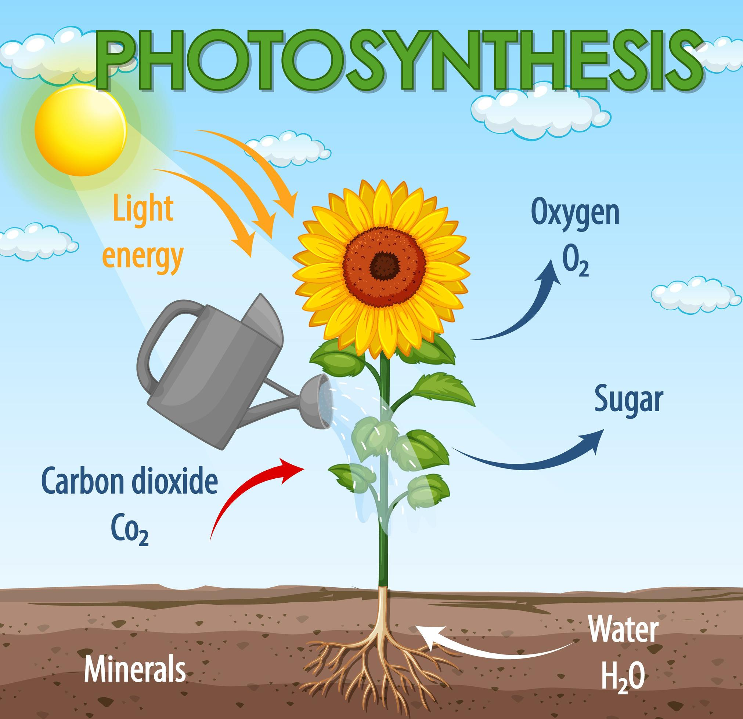

Slide 12
Natural Photosynthesis
Natural photosynthesis occurs in plants, algae, and some bacteria.
These organisms use sunlight, water, and carbon dioxide to produce food and oxygen.
The process removes carbon dioxide, a greenhouse gas, from the atmosphere.
Natural photosynthesis is not very efficient.
Most plants have an efficiency of less than 1%.
Microalgae grown in bioreactors reach only about 3% efficiency.

Slide 13
Most living organisms on Earth depend on photosynthesis.
Photosynthesis is carried out by plants, algae, and some bacteria.
These organisms use sunlight to make their own food. During this process, oxygen is released into the air.
Energy is stored in the form of glucose .
Herbivores get this energy by eating plants.
Carnivores get energy by eating herbivores.

Slide 14
BIONIC LEAF:
The bionic Leaf is a biomimetic system that gathers solar energy via photovoltaic cells that can be stored or used in several different functions.
Bionic leaves can be composed of both synthetic (metals, ceramics, polymers, etc.) and organic materials (bacteria).
The Bionic Leaf has the potential to be implemented in communities, such as urbanized areas to provide clean air as well as providing needed clean energy.

Slide 15
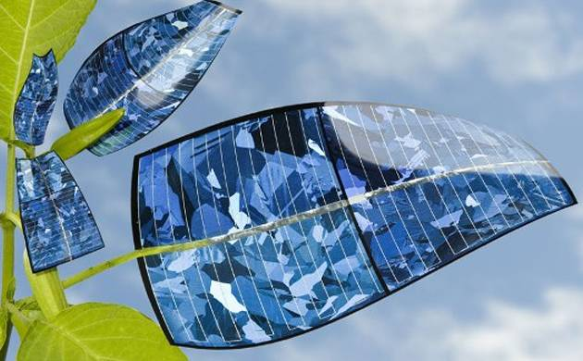
Bionic Leaf and Artificial Photosynthesis

Slide 16
The Bionic Leaf is an artificial system that mimics natural photosynthesis.
It performs artificial photosynthesis.
The Bionic Leaf is about ten times more efficient than natural photosynthesis.
It uses catalysts to capture carbon dioxide from the air.
Captured carbon dioxide is converted into useful fuels such as isopropanol and isobutanol.

Slide 17
Reason for Higher Efficiency of Bionic Leaf
Natural photosynthesis has many energy loss steps.
These energy bottlenecks reduce overall efficiency.
Artificial systems avoid these natural limitations.
Existing artificial systems are efficient but often cannot fix carbon dioxide fully.
When Bionic Leaf catalysts are combined with the bacterium Ralstonia eutropha, a hybrid system is formed.
This hybrid system can fix carbon dioxide effectively.
More than 50% of the input energy is stored as useful chemical products.

Slide 18
Components of a Bionic Leaf
A bionic leaf is a biohybrid system that converts sunlight into chemical energy.
1. Photosynthetic Organism
Uses organisms such as cyanobacteria or genetically modified plants.
Contains pigments like chlorophyll to absorb sunlight.
2. Light Harvesting System
Captures sunlight efficiently.
May use artificial dyes or semiconductor materials.

Slide 19
3. Catalysts
Help in water splitting and carbon dioxide conversion.
Can be enzymes like hydrogenase and nitrogenase.
Can also be synthetic catalysts like Rubisco.
4. Electron Transfer Pathway
Transfers electrons produced during water splitting.
Enables chemical reactions for fuel production.
5. Carbon Dioxide Source
Supplies CO₂ needed for photosynthesis.
CO₂ can come from air or industrial emissions.
6. Energy Storage
Stores energy in chemical form.
Produces hydrogen gas or liquid fuels.

Slide 20
7. Control and Monitoring System
Controls light intensity, temperature, pH, and CO₂ levels.
Improves efficiency and system stability.
Applications of Bionic Leaf
Renewable Energy Production: Produces clean fuels using sunlight.
Agriculture: Enhances plant growth and improves crop yield.
Environmental Remediation: Helps remove pollutants from air, water, and soil.

Slide 21
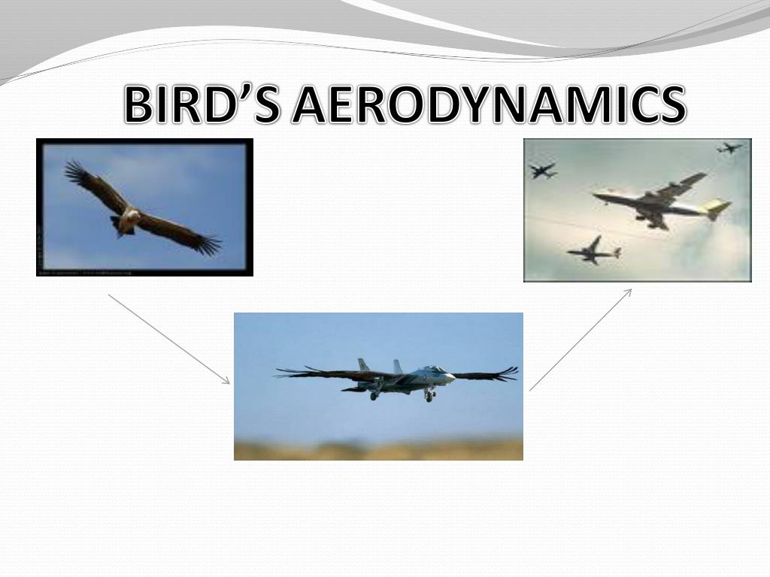

Slide 22
BI R D FLYI NG:
Birds fly by flapping their wings.
They use their body weight and air movement to stay in the air.
Birds navigate using visual cues.
They also use the Earth’s magnetic field.
Birds use the sun and stars for navigation.
Aircraft use engines to produce thrust.
Their wings create lift to keep them in the air.
Aircraft navigate using instruments and systems.
GPS helps aircraft find their position.
GPS uses signals from satellites.

Slide 23
Birds and aircraft can both fly.
Their flying methods are different.
Their navigation methods are also different.
Bird flight inspired the invention of aircraft.
Early inventors like the Wright brothers studied birds.
They observed how birds used wings and body movement.
This knowledge helped improve aircraft design.
GPS was not inspired by birds.
GPS was developed for accurate navigation.
It is used in aviation for navigation and safety.

Slide 24
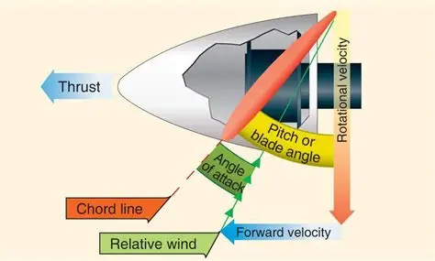
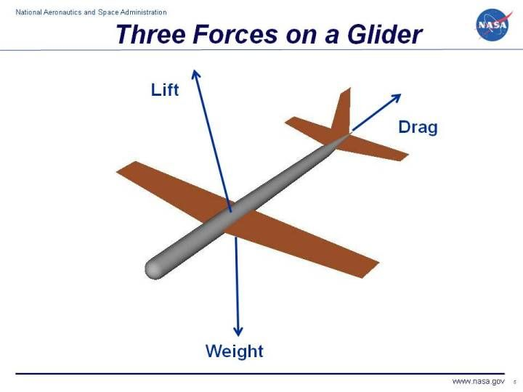

Slide 25
AIRCRAFT:
MECHANISM
Bird flight and aircraft flight follow similar principles.
Both use aerodynamic forces.
These forces are lift, drag, and thrust.
Lift is produced when air flows over the wings.
A wing is shaped like an airfoil.
The airfoil shape creates an upward force.
Air is pushed downward as lift is created.
Some birds also get lift from airflow around their bodies.
This happens especially when wings are folded or partly folded.

Slide 26
Drag is a force that acts opposite to motion.
Drag causes loss of energy during flight.
There are two main types of drag.
Lift-induced drag comes from producing lift.
This drag creates wingtip vortices.
Parasitic drag comes from air friction and body shape.
Skin friction drag is caused by air rubbing against surfaces.
Form drag is caused by the bird’s front area.
Birds have streamlined bodies.
Streamlining reduces drag forces.
Birds do not have engines.

Slide 27
Birds generate thrust by flapping their wings.
Thrust depends on wing movement, speed, and frequency.
Thrust moves an aircraft forward.
It is produced by propellers or engines.
Air is pulled in and pushed out backward.
Drag slows an object down.
Drag acts opposite to thrust.
Weight is caused by gravity.
Lift keeps an airplane in the air.
Wings create most of the lift.

Slide 28
Each force has an opposite force.
Lift works against weight.
Thrust works against drag.
Balanced forces allow level flight.
More lift and thrust cause the plane to rise.
More gravity and drag cause the plane to descend.
Lift pushes upward like drag pushes backward.
Air pressure is higher below the wing.
This higher pressure pushes the wing upward.

Slide 29
LOTUS LEAF EFFECT
The lotus leaf has a highly water-repellent surface.
This property is called super hydrophobicity.
It is known as the lotus effect.
Water repellency is important for self-cleaning materials.
Scientists study this effect in nature and artificial systems.
The lotus effect allows lotus leaves to repel water.
It also helps the leaf clean itself.
The lotus leaf has a special surface structure.
The surface has very small bumps.
It also has wax-coated tiny hairs.
These structures exist at micro and nano scales.
They create a high contact angle with water droplets.

Slide 30
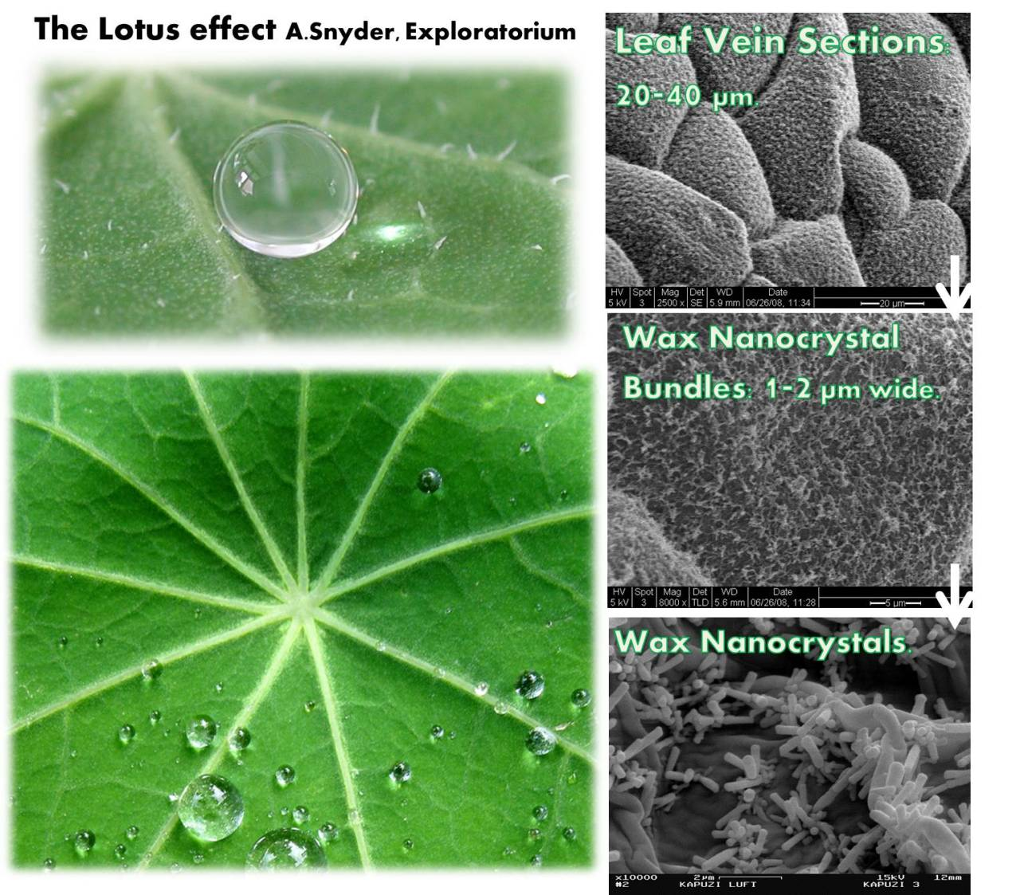

Slide 31
Water droplets do not stick to the surface.
The droplets roll off easily.
Rolling water carries away dirt and dust.
This makes the leaf self-cleaning.
The leaf resists water and dirt adhesion.
The lotus effect inspires modern technology.
Scientists develop superhydrophobic surfaces using this idea.
These surfaces are also self-cleaning.
Such surfaces are used in many industries.
They are used in aerospace and automotive industries.
They are used in building materials and medical devices.
Self-cleaning coatings reduce cleaning and maintenance.
Superhydrophobic coatings help prevent ice formation on aircraft wings.

Slide 32
Superhydrophobic surfaces can clean themselves.
Normally, cleaning happens when water droplets roll or hit the surface.
This process usually needs external forces like gravity.
A new self-cleaning method is demonstrated here.
The surface is exposed to water vapor.
Water vapor condenses into tiny liquid droplets.
The droplets form on the contaminated surface.
These droplets partially or fully surround dirt particles.
The droplets then jump off the surface.
This jumping happens without gravity or external force.
The jumping motion removes the dirt particles.
The motion is caused by surface energy release.
Surface energy is released when small droplets merge.
This process is called droplet coalescence.

Slide 33
The jumping droplets carry contaminants away.
This mechanism was observed on cicada wings.
Dirt on cicada wings cannot be removed by gravity.
Wind and wing vibration also cannot remove the dirt.
The jumping droplets clean the wings effectively.
This discovery helps in designing new self-cleaning materials.

Slide 34
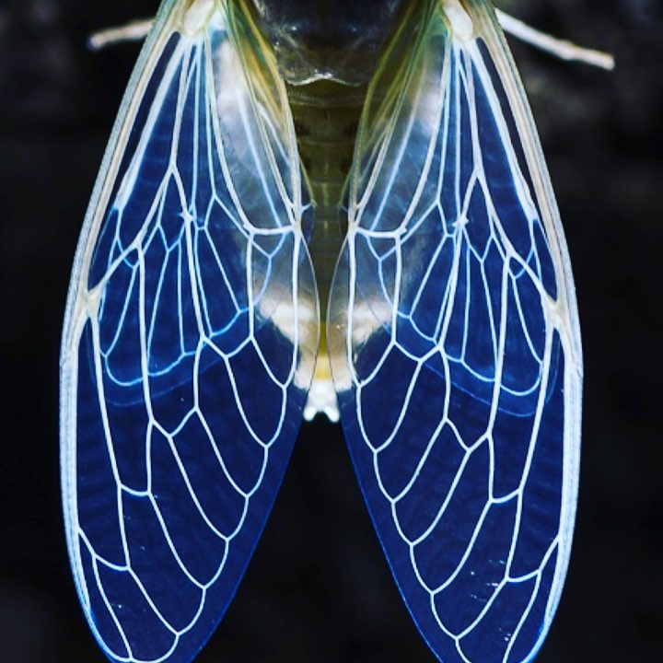

Slide 35
Mechanism
The self-cleaning process happens automatically.
It occurs on superhydrophobic surfaces.
Water vapor condenses on the surface.
Condensed water covers or surrounds dirt particles.
Small water droplets merge together.
Merging releases surface energy.
This energy causes the droplet to jump.
The jumping droplet removes dirt particles.
The droplet size is similar to or larger than the particle size.
In another case, particles group together.
Water condensation causes this grouping.
The group of particles jumps away from the surface.
This also cleans the surface effectively.

Slide 36
PLANT BURRS and VELCRO
Some plants, like burdock, have burrs that stick to clothes and animal fur.
These burrs have tiny hooks that help the plant spread its seeds.
A Swiss engineer named George de Mestral noticed this in 1941.
He studied the burrs under a microscope and saw the hook shape.
This idea inspired him to invent Velcro.
Velcro has two strips: one with hooks and one with loops.
When pressed together, the hooks catch the loops and hold tightly.
Velcro is easy to open and close, so it is used in clothes, shoes, bags, and medical items.
The name Velcro comes from the words velvet and crochet.

Slide 37
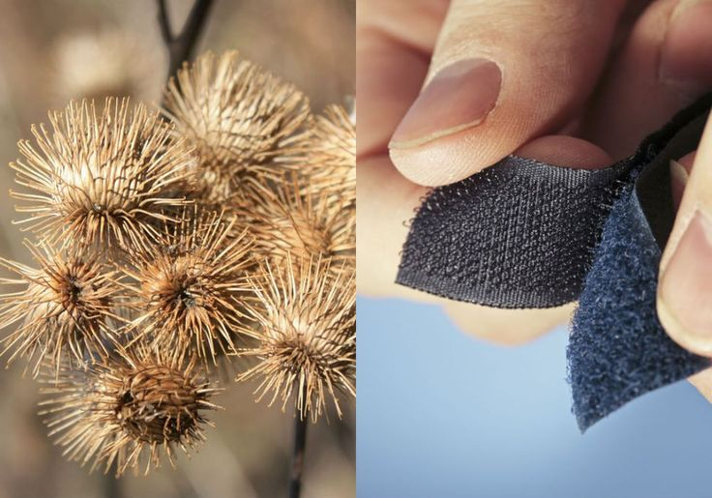
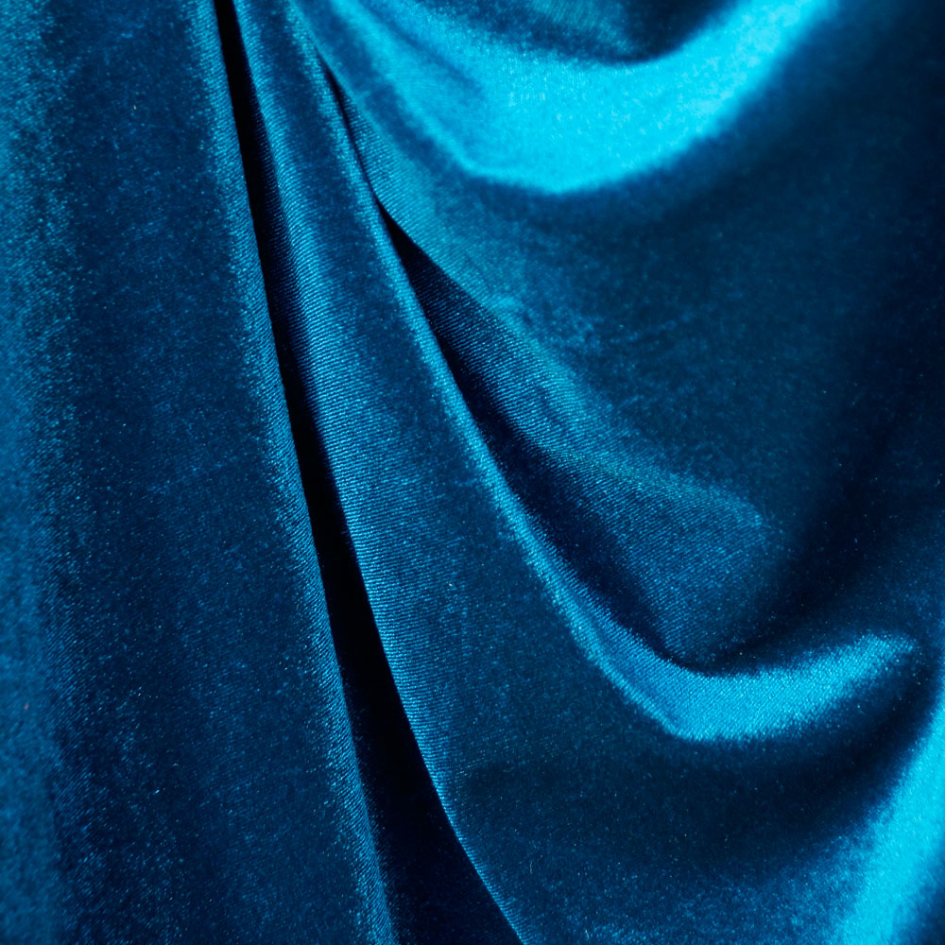
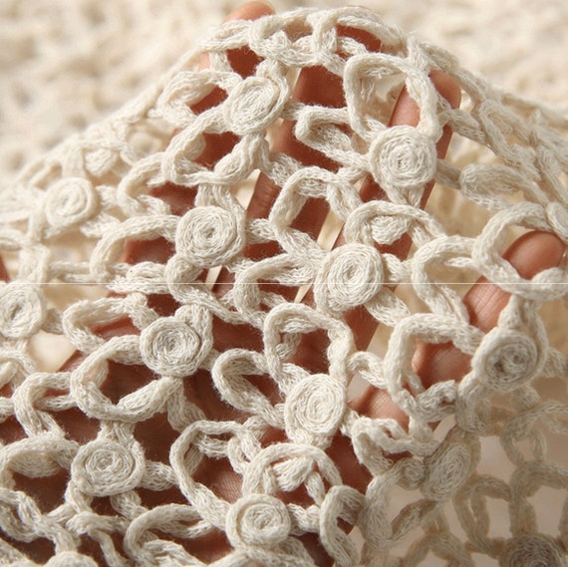
velvet and crochet.

Slide 38
Used in clothing and footwear for easy fasteners and adjustable straps. • Helpful for people with limited movement because it is easy to open and close. • Used in medical devices like braces and splints for secure fastening. • Used in aerospace to hold parts in place during launch and flight. • Used in automobiles to fix carpets, panels, and seat cushions. • Used in packaging for resealable bags and pouches. • Used in sports equipment like helmets and gloves for adjustable fitting.

Slide 39
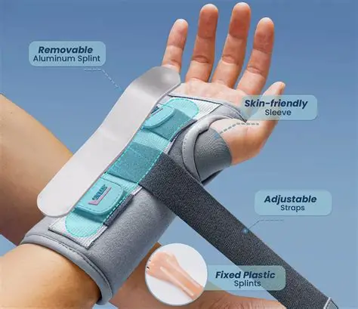

Slide 40
Shark Skin and Friction-Reducing Swim Suits
Shark skin has tiny structures called denticles that reduce water resistance. These denticles disturb water flow and reduce turbulence around the shark’s body. By reducing turbulence, sharks can swim faster with less energy.
Turbulence occurs when water flows in an irregular and chaotic way. Turbulence increases resistance and makes movement through water difficult. Reducing turbulence helps swimmers move more efficiently.
The denticles on shark skin break up turbulent water flow. This makes the water flow smoother and reduces drag. As a result, the shark swims faster and more efficiently.

Slide 41
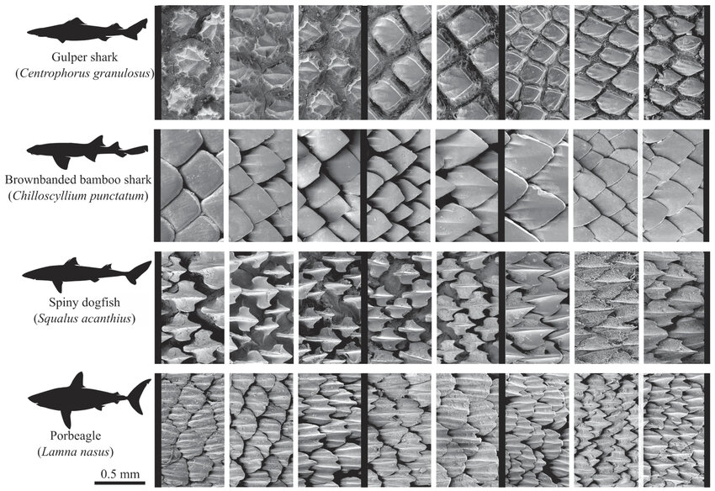

Slide 42
Friction-Reducing Swim Suits
Shark skin inspired the development of friction-reducing swim suits. These swim suits reduce drag and improve swimmer performance. They are made using structures similar to shark skin denticles.
Materials Used in Swim Suits
Polyurethane is used because it is durable and can be shaped easily. Lycra or spandex provides stretch and flexibility.
High-tech fabrics like silicone- or Teflon-based materials help reduce water resistance.

Slide 43
Kingfisher Beak and Bullet Train
The kingfisher beak is designed for efficient diving into water.
Its long, pointed shape reduces air and water resistance. The streamlined beak helps the bird dive with less energy.
The sharp beak breaks the water surface easily by reducing surface tension.
It also reduces splash, helping the bird catch fish quietly.

Slide 44
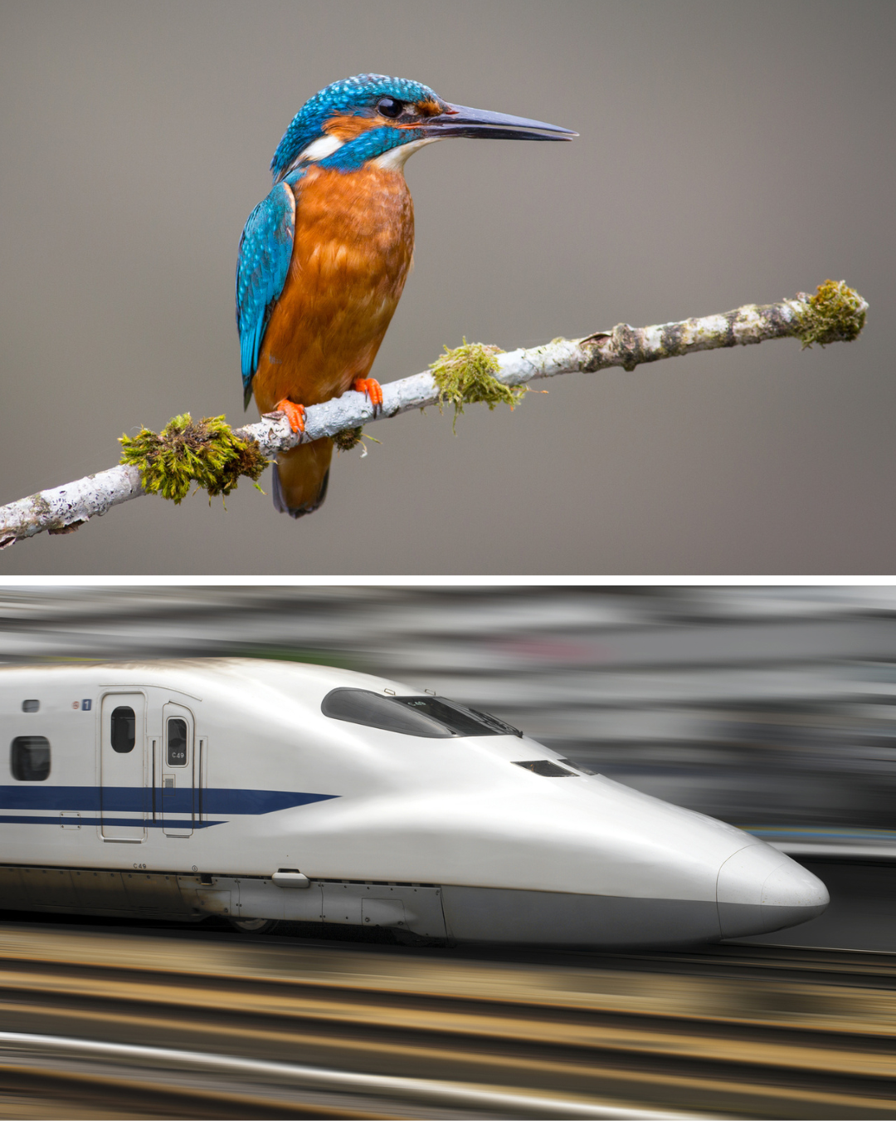

Slide 45
Technological Importance
Engineers used the kingfisher beak as inspiration for the Shinkansen bullet train in Japan.
This is an example of biomimicry in engineering.
The front of the bullet train is streamlined to reduce air resistance.
This improves speed, stability, and energy efficiency.
The design also reduces noise and vibration.
When the train enters tunnels, pressure waves are formed.
The beak-shaped nose reduces these pressure waves.
This lowers noise and improves passenger comfort.

Slide 46
HUMAN BLOOD SUBSTITUTES
There is often a shortage of donated blood, and sometimes donated blood may not be fully safe.
Because of this, scientists are trying to develop blood substitutes.
Blood substitutes are mainly of two types: volume expanders and oxygen carriers.
Volume expanders, like saline, replace the liquid part of blood.
Oxygen carriers are designed to carry oxygen like red blood cells do.
Developing oxygen carriers has been more difficult than volume expanders.
One early type of oxygen carrier was perfluorocarbons (PFCs).
PFCs can carry oxygen well but cause side effects like flu-like symptoms and are not broken down by the body.

Slide 47
Umbilical cord blood is also being studied as a source of red blood cells.
Cord blood can be tested for infections and stored safely.
However, safe collection, ethical issues, and proper storage are still major concerns.
Two main artificial blood products are HBOCs and PFCs.
Many clinical trials showed mixed results, and some patients had a higher risk of heart problems.
Later studies showed that not all blood substitutes are equally dangerous, and some may be safer than first believed.
HBOCs are made from natural hemoglobin and can release oxygen to tissues

Slide 48
They help preserve organs for transplantation by reducing damage and increasing preservation time.
PFCs stay in the blood for about 48 hours and can dissolve large amounts of oxygen.
They must be mixed into an emulsion before use because they do not mix with blood.
PFCs are also being studied for reducing brain swelling after injury, but they may cause flu-like symptoms in some patients.

